Slide 1
Time series

Slide 2
Introduction
Series of data points in time order.
Usually at regular intervals
Analysis
Statistics & Characteristics
Forecasting
Use old values to predict future

Slide 3
Usecases
Analysis
Trends & Correlations
Signal processing
Clustering & Classification
Prediction
Weather, finance, …

Slide 4
Analysis methods
Statistics
Mean, Standard deviation, …
Plotting & Curve Fitting
Autocorrelation
Spectral analysis
Classification
Patterns
Notes:
Plotting: visual analysis
Curve fitting: find function that approximates data best (possible to then use it for prediction)
Autocorrelation: serial dependence
Spectral analysis: cyclic behavior
Classification: classify temporal patterns

Slide 5
Forecasting methods
Regression
ARIMA
Combination of AR, I, MA
RNN & LSTM
Neural networks

Slide 6


ARIMA
Auto Regressive
Future values depend on old values
Integration
Difference between values is stationary
Moving Average
Future values depend on old values’ distance from mean
Notes:
Stationary: mean and variance don’t change

Slide 7
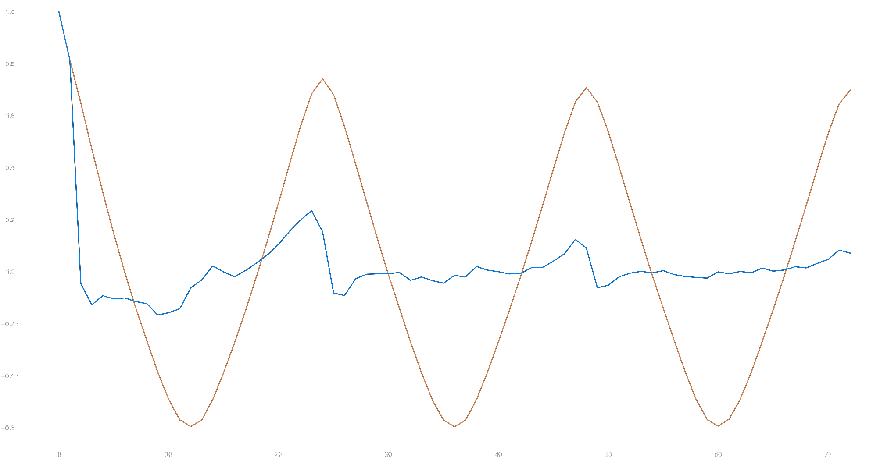
ARIMA – Picking the orders
p, d & q
Orders for each part (AR, I, MA)
Autocorrelation & Partial Autocorrelation
Augmented Dickey-Fuller test
Stationarity of series
Notes:
If correlation > 1 => interest
Look to partial correlation if falls fast => only AR (order of point where falls)
If correlation neg, … then MA
ADF: p-value <= 0.05: ok => d = 0

Slide 8
Project
Predict light levels (h+1, h+2, j+1, …)
Direct, indirect, ratio
5 stations (out of 15)
2 years (out of 5)
7 metrics
Every minute

Slide 9
Preprocessing
Remove empty

